Slide 1
Problem Statement: Hardware Design Engineer for Payload Electronics Development
Design of a high-accuracy Peizo-actuator control electronics for an Earth Observation (EO) payload.

Slide 2
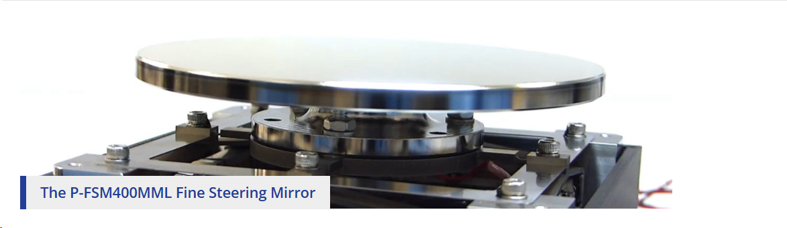
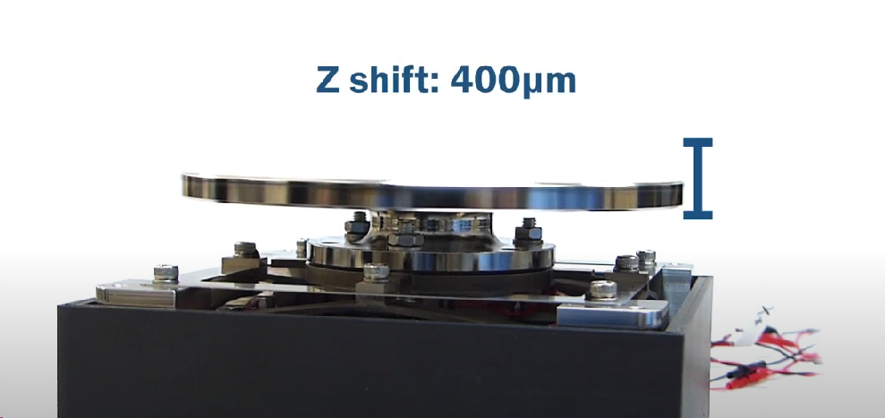
1. Piezo Actuator
Actuator Specs
Full stroke length: 400 micrometers
Tip/tilt angle: 1 degree
Precision of actuation: 100 nanometers
P/N : P-FSM400MML Fine Steering Mirror

Slide 3
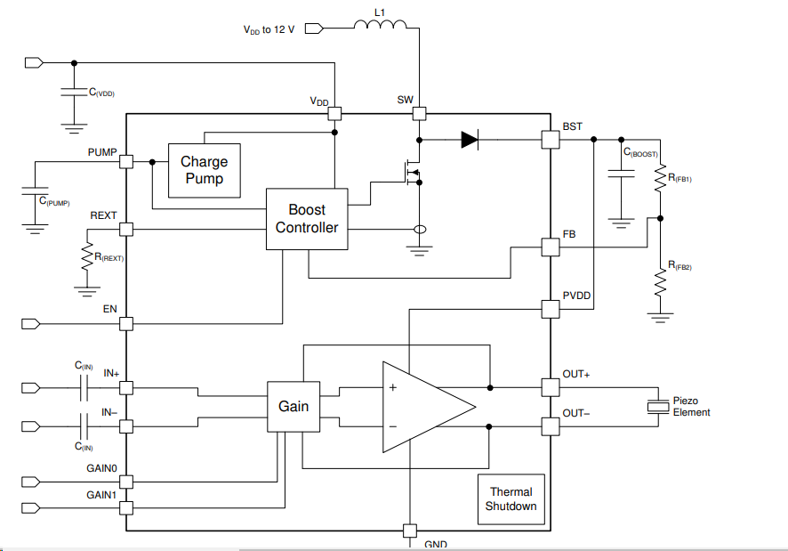
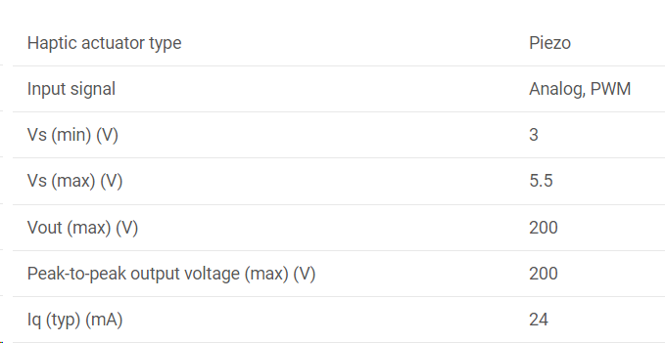
2. Piezo Actuator Driver
Actuator Drive specs
Drive Voltage Range: -20 V to +150 V
Load Impedance: 15 pF
Peak power: <5 W
Supply voltage: 5 V DC
DAC resolution: 12 bits
Linearity error :<0.01%
P/N : DRV2700: Industrial piezo driver with integrated 105-V boost converter

Slide 4
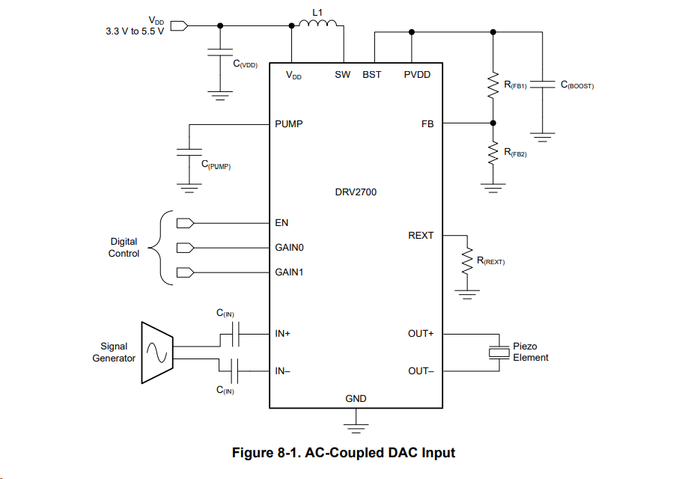
Piezo Actuator Driver Circuit
Note: Use a 1:1 isolation transformer at out+ and out- pins to protect piezo actuator from external disturbances
Note: Use a Balun to Convert single ended o/p of DAC o/p to Differential signal

Slide 5
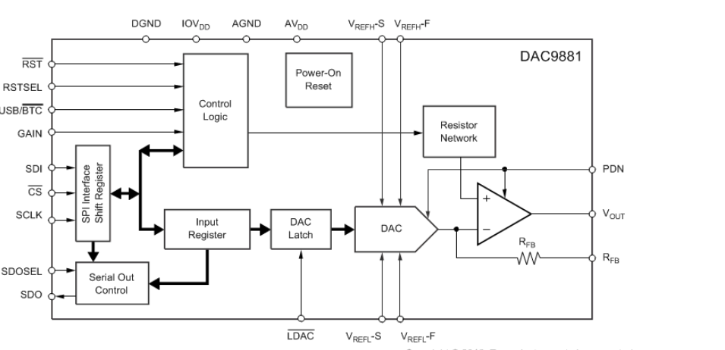
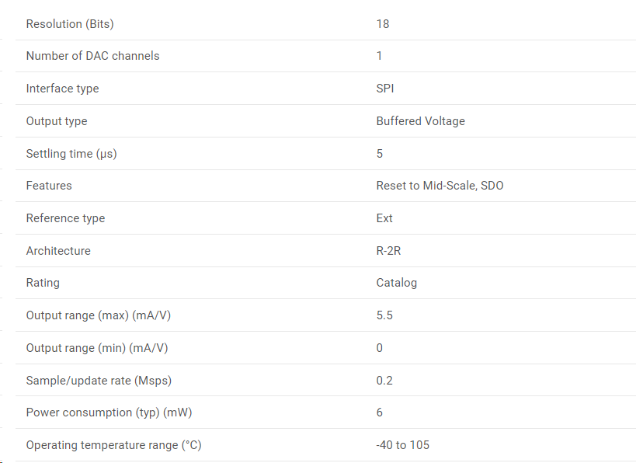
3. Voltage O/P DAC
P/N : DAC9881

Slide 6
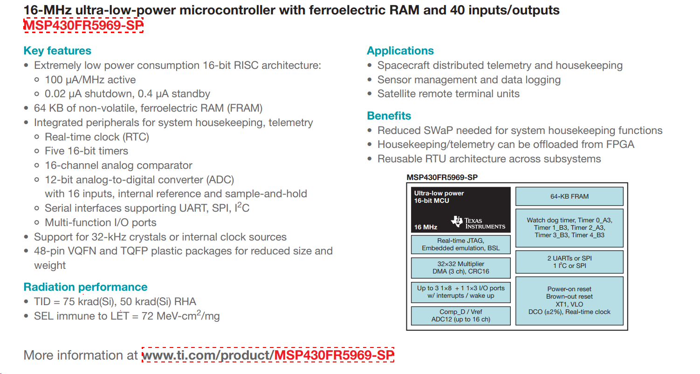
4. Space Grade Microcontroller

Slide 7
P/N: MSP430FR5969
features
1) Core : 16 bit, 16MHz
2) Connectivity: I²C, SPI, UART, 40 GPIO
3)Memory: 256 KB FRAM, 8 KB SRAM
4)Voltage - Supply (Vcc/Vdd): 1.8V ~ 3.6V
Space Grade Microcontroller Specs

Slide 8
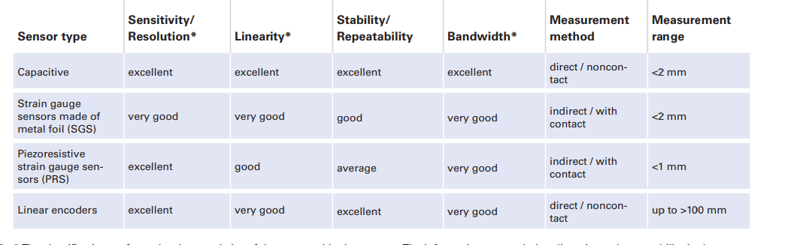
5. Nano-positioning Sensor
A high-resolution position feedback system to continuously monitor the position of the optical component in both pitch and yaw axes is needed. This feedback should be accurate down to nanometer-level precision.
The Solution is : Capacitive sensor

Slide 9
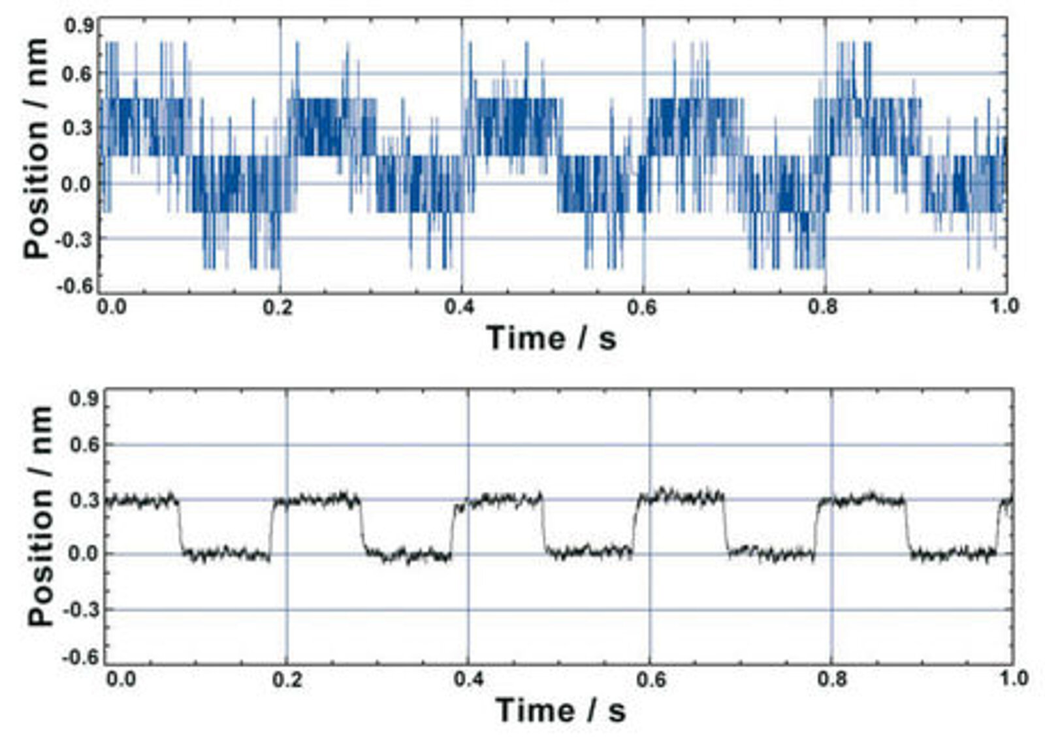
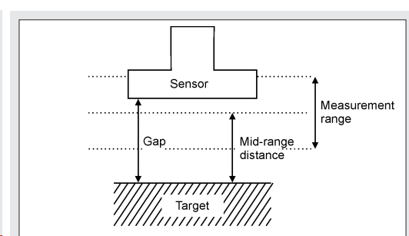
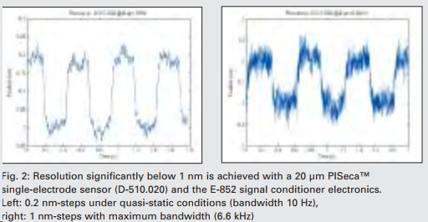

Slide 10
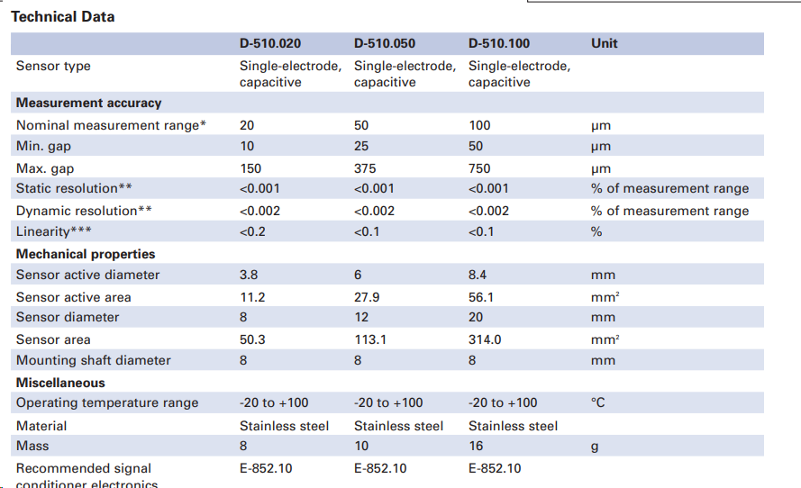
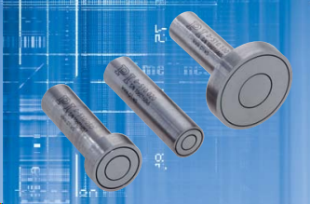
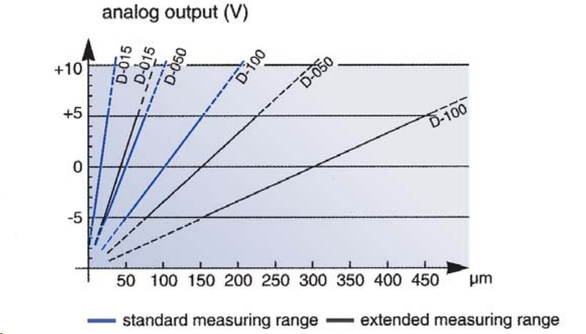
P/N: D-510.100

Slide 11
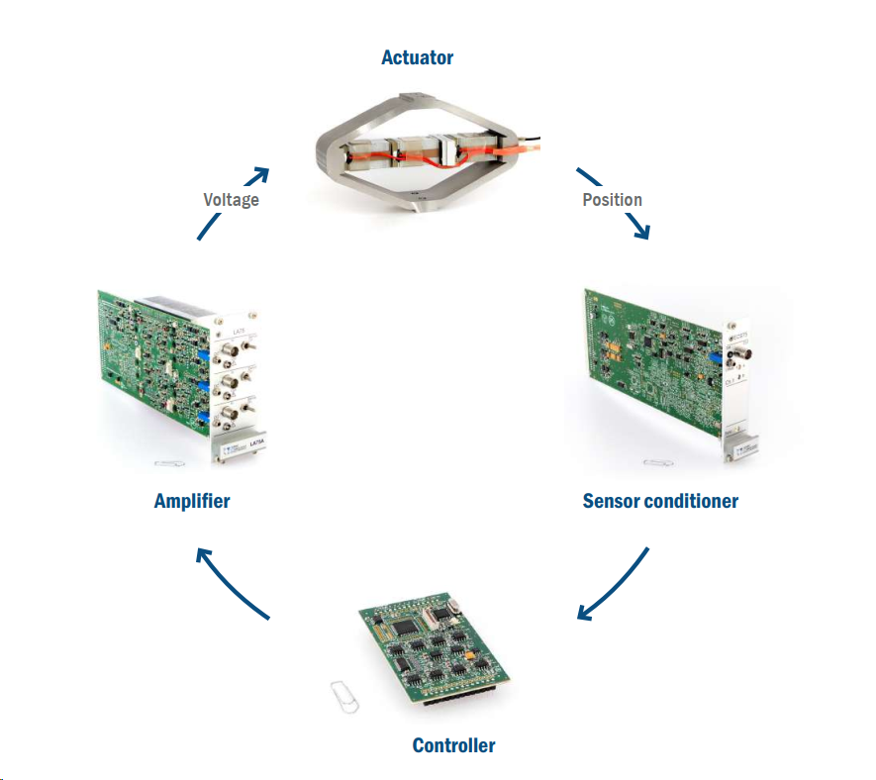
6. Signal Conditioner

Slide 12
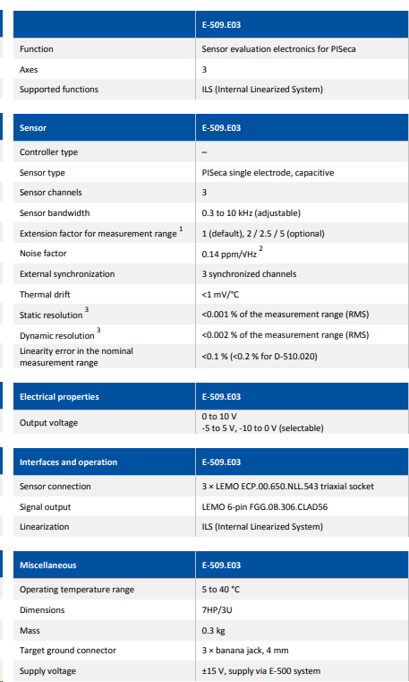
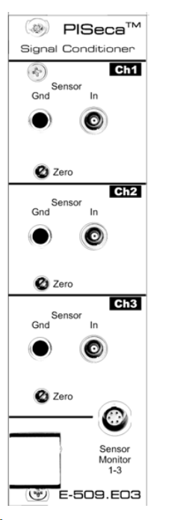
P/N: E-509.E03

Slide 13
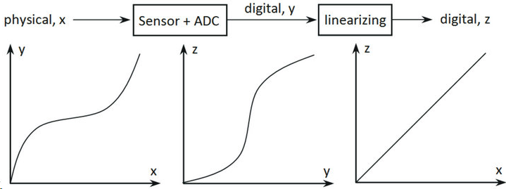
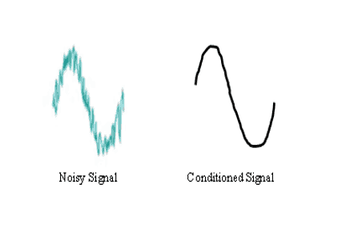
Need For Signal Conditioner:
Removes Noise and amplifies sensor signal, Improves Range.
Improves Linearity
Eliminates Drift and Hysteresis when used in Closed loop operations
ILS Circuitry Maximizes Capacitive Sensor Linearity

Slide 14
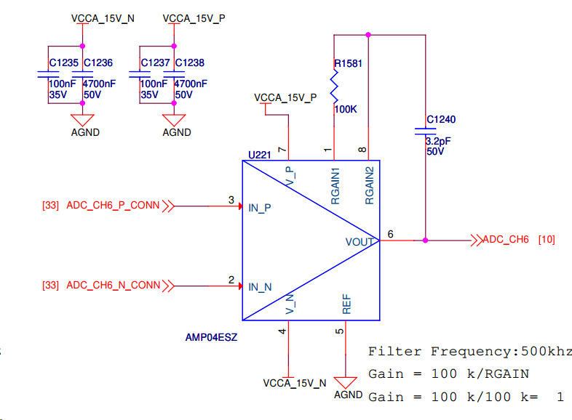
Alternate Signal Conditioner
P/N: AMP04ESZ
AMP04ESZ: Precision Instrumentation Amplifier
Wide gain range: 1 to 1000
Single-resistor gain set
Single pole Low pass Filter setting

Slide 15
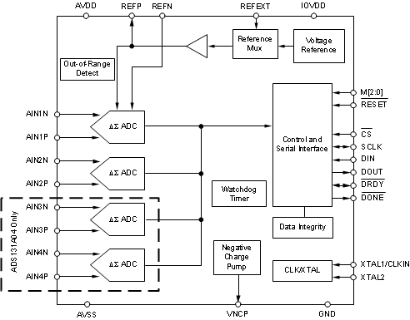
7. Data Acquisition (ADC)
P/N: ADS131A04
Resolution (Bits):24
Sample rate (max) (ksps):128
Number of input channels: 4
Interface Type: Single-ended
Simultaneous Sampling
Multichannel configuration:
Input voltage range : (max) (V) : 4.5
Input voltage range (min) (V) : -1.5
SNR=115.2, ENOB=(SNR(dB)−1.76)/6.02​ = 18.81

Slide 16
Vresolution ​= Input Voltage Range​/ (2^ENOB)
Vresolution ​= 6​/(2^18.81)
Vresolution​ ≈ 18.25μV
5v corresponds to → 150um
18.25μV corresponds to → 0.547nm
The Data Acquisition System is capable of sub nm resolution measurement

Slide 17
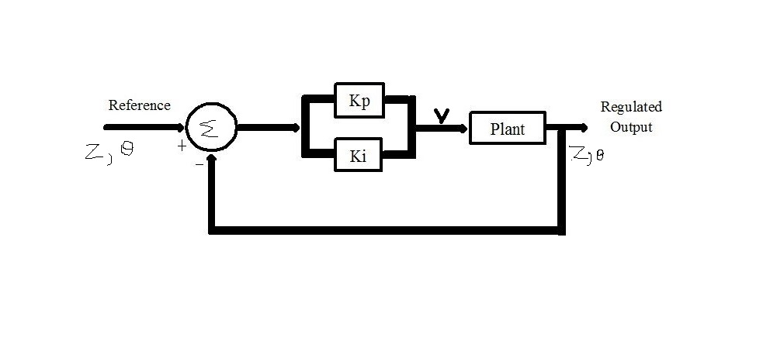
8. Control Algorithm
u[k]= Kp​⋅e[k] + Ki​ *( i=0 to K ∑ ​e[i]⋅Ts​ )
Proportional term addresses immediate deviations, but in cases where there are continuous disturbances(drift and Hysteresis) preventing the system from reaching the setpoint, the integral term is necessary to gradually eliminate the steady-state error by accumulating and responding to the persistent deviation over time.

Slide 18
P I Tuning and Evaluation
P I Controller Setup
Proportional (P) Control:
Start with a proportional-only controller (PI with I term set to zero). Tune the proportional gain (Kp) to achieve a response that is fast but doesn't introduce excessive oscillations.
Integral (I) Control:
Introduce the integral term gradually (increase Ki) to eliminate steady-state error. Be cautious not to introduce too much integral action, as it can lead to instability or overshooting.
Performance Evaluation
Stability Analysis:
Evaluate the stability of the system by checking for overshooting, oscillations, and settling time. Adjust P and I gains accordingly.
Transient Response:
Analyze the transient response of the system to step inputs. Ensure that the response is fast without introducing instability.
Steady-State Error:
Fine-tune the integral gain to minimize steady-state error. This is particularly important in applications where accurate positioning is critical.

Slide 19
9.Block Diagram
DAC
Piezo Driver
Piezo Actuator/s Fine steering Mirror
P.I, Micro Controller
ADC
Signal Conditioner
Non Contact Capacitive Sensors
EO Payload Electronics

Slide 20
10.Major BOM
SL No. | Description | Part No
1 | Fine Steering Mirror | P-FSM400MML
2 | Piezo Actuator Driver | DRV2700
3 | Voltage O/P DAC | DAC9881
4 | Space Grade Microcontroller | MSP430FR5969
5 | Single Electrode Capacitive Sensor | D-510.100
6 | 3 channel Signal Conditioner | E-509.E03
7 | Instrumentation Amplifier | AMP04ESZ
8 | Data Acquisition (ADC) | ADS131A04

Slide 21
THE END
Submitted By: UR Nikhil Bhat
https://www.linkedin.com/in/nikhil-bhat-7121a8144/
+91 81618237278
nikhilbhat920@gmail.com

Slide 22
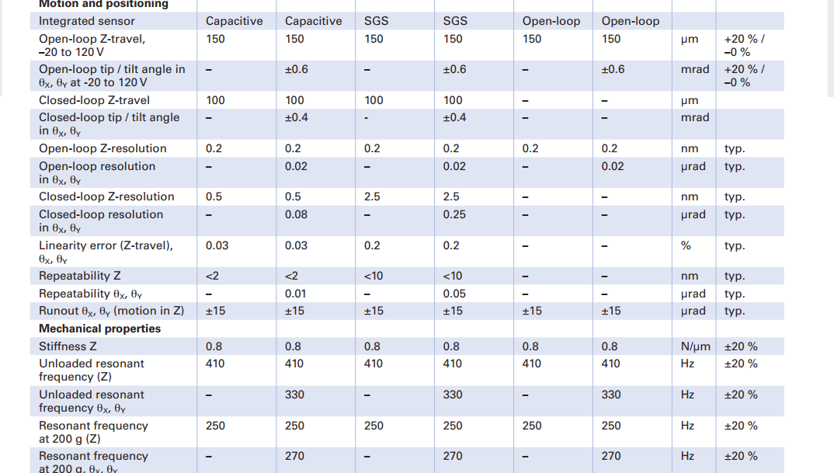
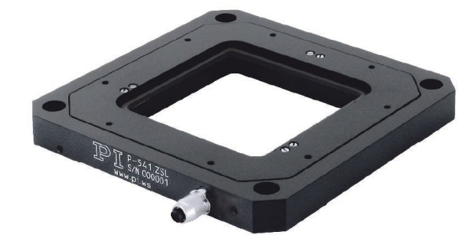
Additional Info
Nanopositioner Z and tip/tilt stage with large aperture

Slide 23
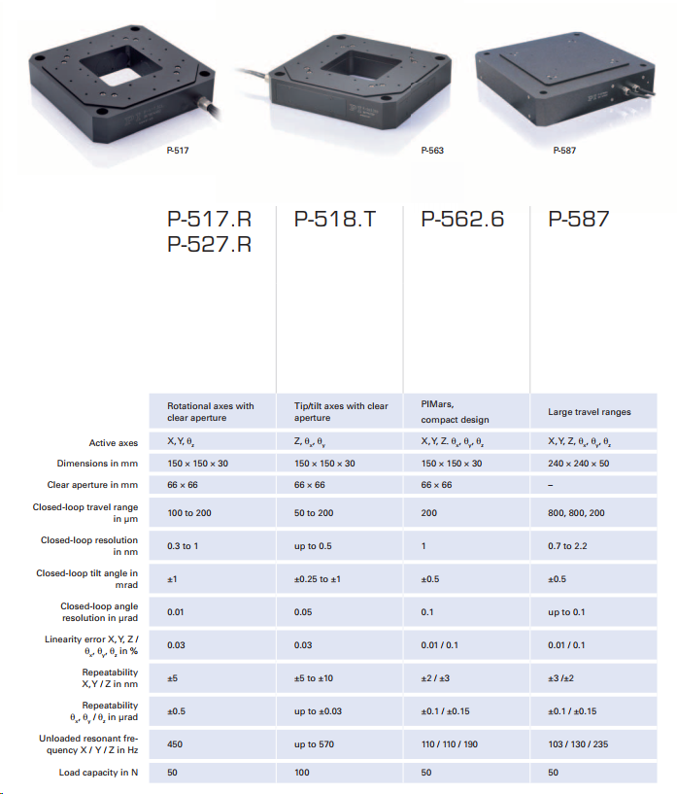

Slide 24
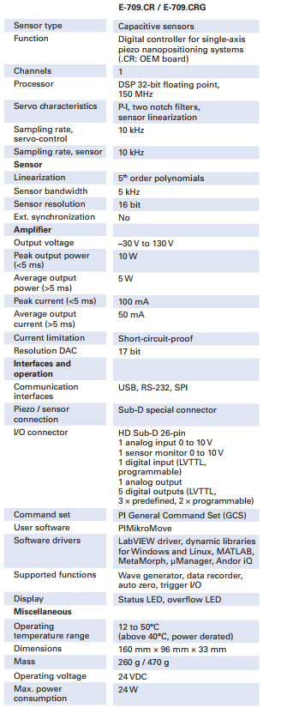
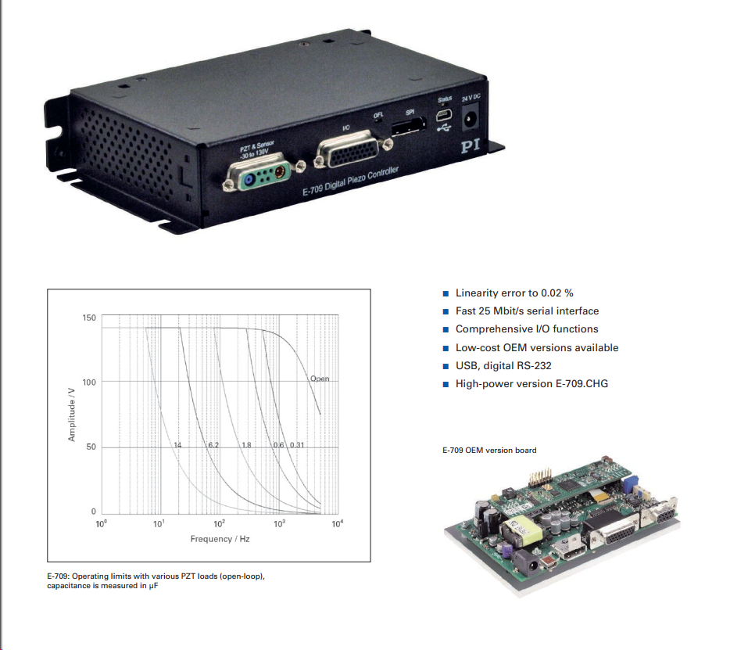
Digital Piezo Controller

Slide 25
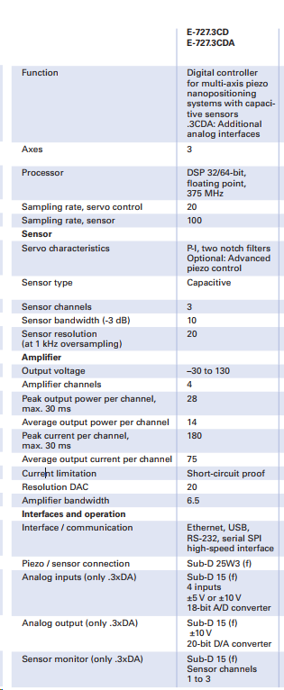
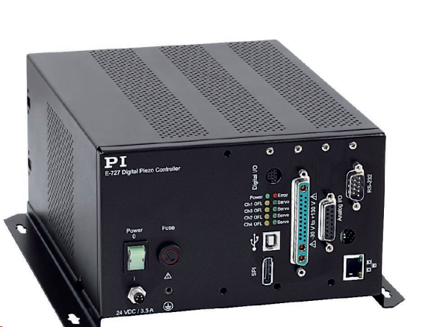
E-727 Digital Multi-Channel Piezo Controller

Slide 26
Features:
=> 3 channel Cap sensing, signal conditioning and sensing via ADC
=> PZT Amplifier for 3 Axis Piezo nanopositioning,
=> DSP Controller with 4th order polynomial linearization for mechanics and electronics
=> Ethernet, USB, RS-232, serial SPI high-speed interface LabVIEW driver, shared libraries for Windows, and Linux

